Slide 1
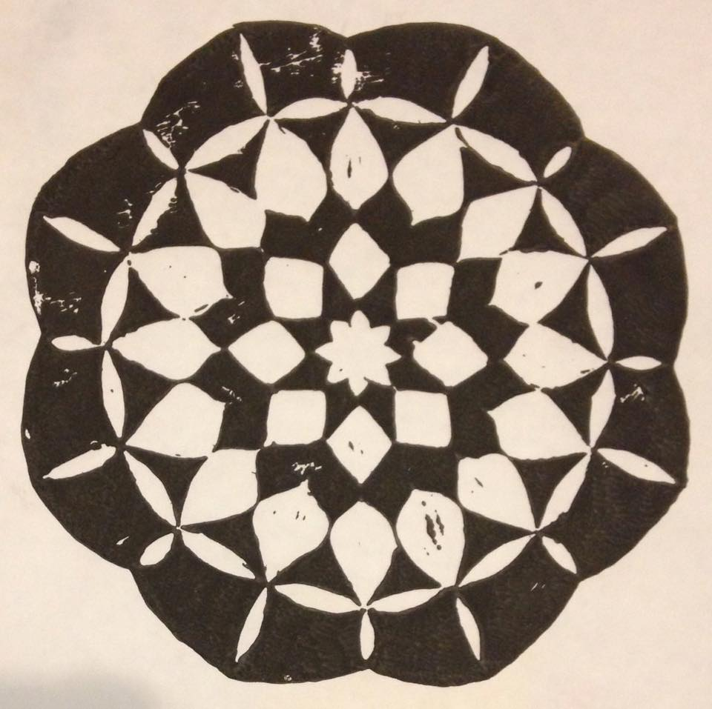
Printing

Slide 2
Printing

Slide 3
Sculptures

Slide 4
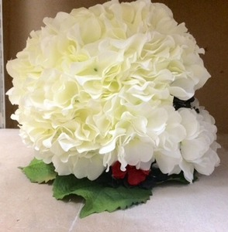
Sculptures

Slide 5
Photoshop

Slide 6
Photoshop

Slide 7
Self Portraits

Slide 8
Self Portraits

Slide 9
Self Portraits

Slide 10
Paintings

Slide 11
Paintings

Slide 12
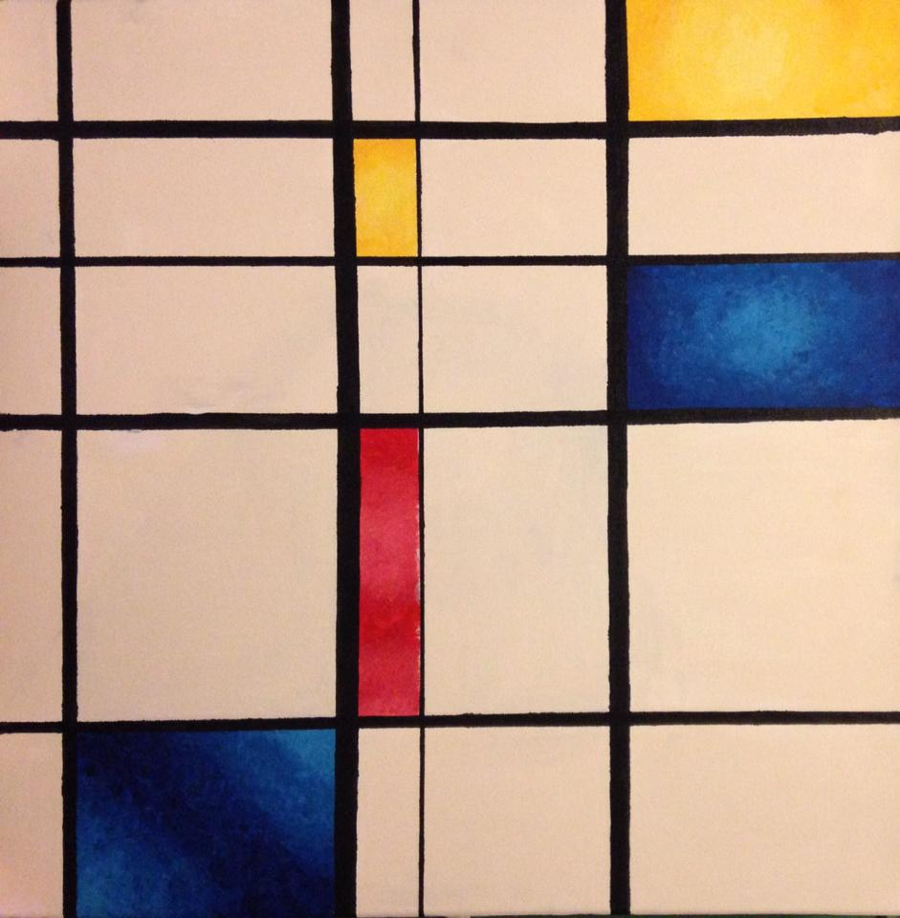
Paintings

Slide 13
Oil Paintings

Slide 14
Wax

